Slide 1
Linux 시스템 프로그래밍
2018년 1학기
성병문
한세대학교 일반대학원

Slide 2
목차
Chapter 1 : Introduction and Essential Concpets
교과목 개요 / 실습 환경 구성
Linux 역사 / Linux 시스템 프로그래밍 개요
예제 프로그램 작성 / Linux 주요 명령어
Chapter 2 : File I/O
File Open
File Write
File Seek
File Copy Program 실습
Chapter 3 : Buffered I/O
Qt 프로그램 예제
User-Buffered I/O
fopen/fclose
fwrite 실습
Network Programming
fork / thread
1 : 1 Socket Programming by using fork
1 : N Socket Programming by using thread
Network Protocol Pogramming
Raspberry Pi Programming

Slide 3
교과목 개요
과목명: 고급 프로그램
학점 및 시간 : 2학점(이론 1시간, 실습 1시간)
강의 개요
Linux 시스템콜과 라이브러리 이용 방법
교재:
제목 : LINUX SYSTEM PROGRAMMING 2nd Ed.
저자/출판사/년도 : Rovert Love / O'REILLY / 2013
URL:
https://moodle2.units.it/pluginfile.php/110718/mod_resource/content/2/Linux%20System%20Programming%2C%202nd%20Edition.pdf
Errata: http://www.oreilly.com/catalog/errata.csp?isbn=9781449339531

Slide 4
메모
GIT Repository
https://github.com/sunabove/lec_100_linux

Slide 5
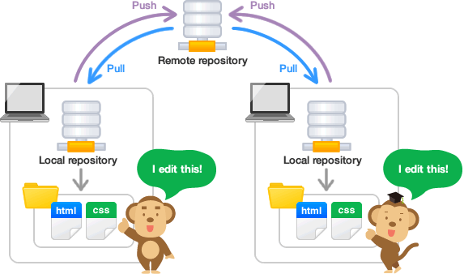
GIT 소스 코드 관리
소스 코드 공유 및 버전 관리
https://backlogtool.com/git-guide/en/

Slide 6
GIT sequence diagram
Local Repo
Remote Repo
clone (복사/한번만)
add (변경 파일 등록)
commit (변경 파일 기록)
branch (가지 치기)
merge (가지 병합)
push (변경 파일 보내기)
pull (변경 파일 가져오기)

Slide 7
Git Usage
Git Repository Clone
$ git clone https://github.com/sunabove/lec_100_linux.git
Git pull : 서버 내용을 로컬 폴더로 동기화 함.
$ cd lec_100_linux
$ git pull
Git file 초기화 : git pull 에러 발생시
$ git reset --hard HEAD
Git 아이디/암호 저장
$ git config credential.helper store

Slide 8
실습 환경 구성 1
Linux 운영체제 설치
VmWare workstation 최신판
Ubuntu Desktop LTS 최신판
gcc 설치
$ sudo apt upgrade
$ sudo apt update
$ sudo apt install gcc
$ sudo apt install g++
Git 설치
$ sudo apt install git
Visual studio code 편집기 설치
$ sudo snap install vscode --classic

Slide 9
bash 설정
환경변수 조회
printenv
PATH 환경 변수 조회
printenv | grep PATH
echo $PATH
현재 폴더를 PATH에 추가하기
사용자 홈 디렉토리의 .bashrc 파일 마지막 줄에 아래의 문장 추가
export PATH=$PATH:.

Slide 10
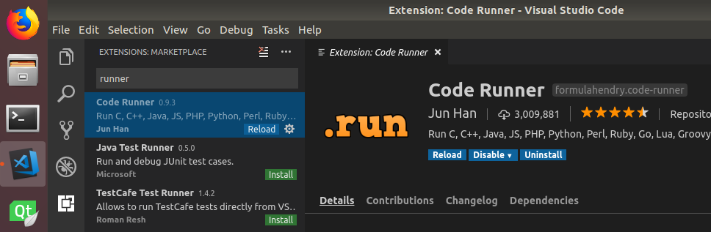
실습 환경 구성 2
Visual Source Code Extension 설치
Code Runner Extension 설치

Slide 11
실습 환경 구성 3
Visaul Studio Code User Setting
File -> Preferences -> Settings
User Setting
{
"code-runner.executorMap": {
"c": "cd $dir && gcc $fileName -o a.out && $dir/a.out" ,
} ,
"files.exclude": {
".vscode": true,
".vimrc" : true,
".gitignore": true,
"**/*.o" : true,
"**/*.out" : true,
} ,
"code-runner.runInTerminal": true ,
}

Slide 12
실습 환경 구성 4
Qt5
https://www.qt.io/
Qt5 설치
sudo apt install qtcreator
sudo apt install qt5-default
sudo apt install qtdeclarative5-dev
Qt5 문서 설치
sudo apt install qt5-doc qt5-doc-html qtbase5-doc-html qtbase5-examples

Slide 13
실습 환경 구성 6
Net-tools 설치
sudo apt install net-tools
네트웍 환경 확인
$ ifconfig

Slide 14
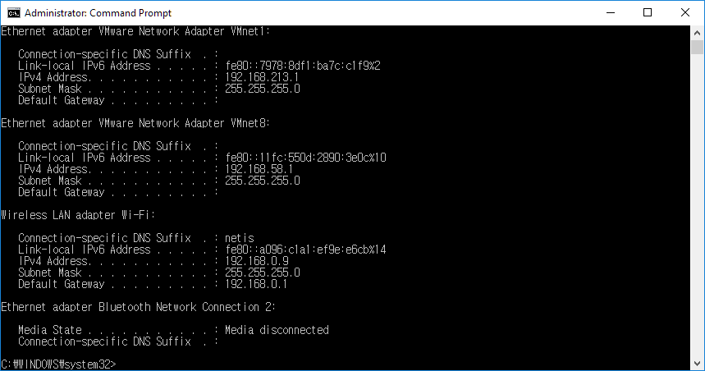
PC Windows 10 네트웍 환경 확인
cmd 창 실행
ipconfig
ip 주소가 192.168.0.xxx 임을 확인한다.
IP 주소 확인

Slide 15
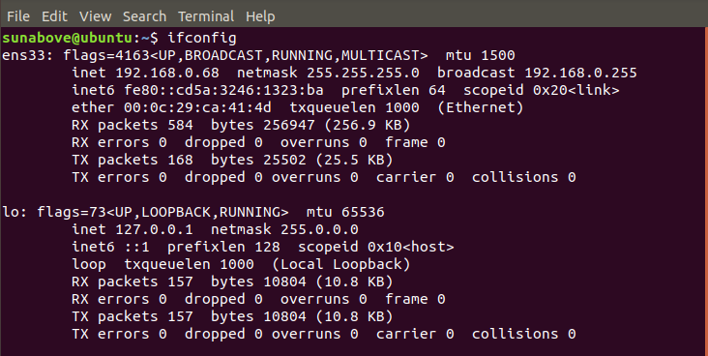
Linux 네트웍 환경 확인
터미널 실행
$ ifconfig
ip 주소가 192.168.0.xxx 임을 확인한다.

Slide 16
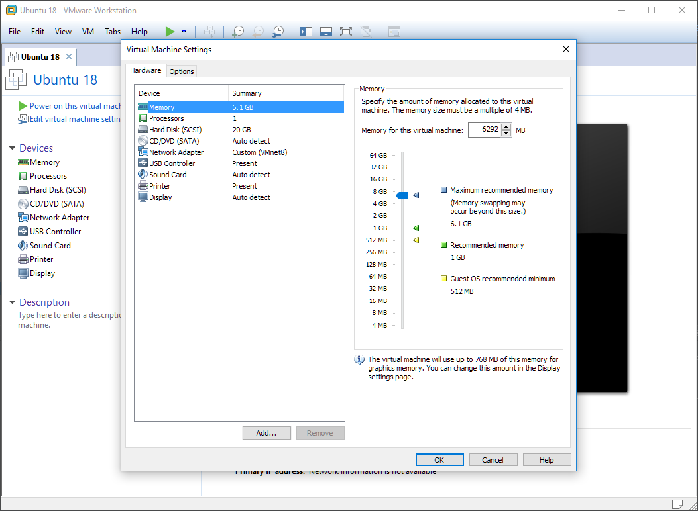
VM 메모리 설정
메모리를 최대 추천 메모리 크기로 설정.

Slide 17
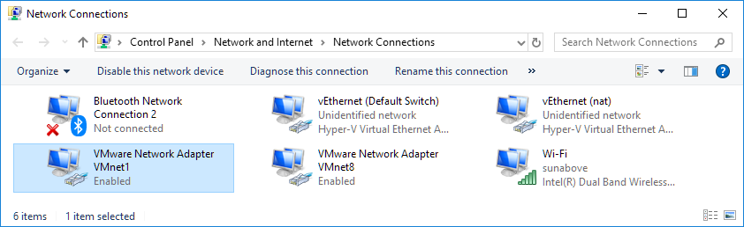
VMWare Network Adapter
WindowKey + X -> Settings -> Network & Internet -> Change adaptor options
Default
Virtual VMWare
Network Adapter
Physical Wi-Fi
Network Adapter

Slide 18
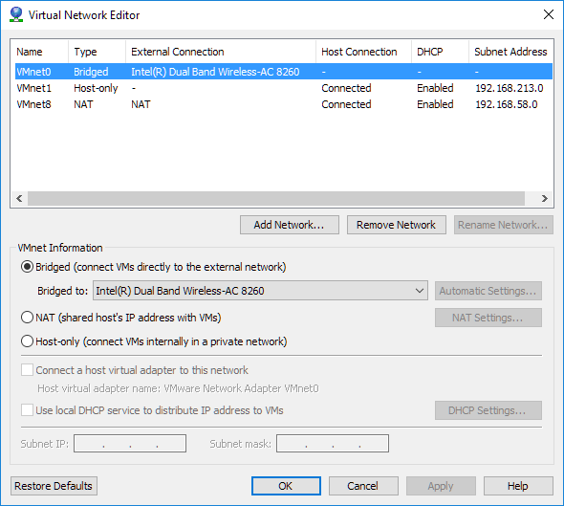
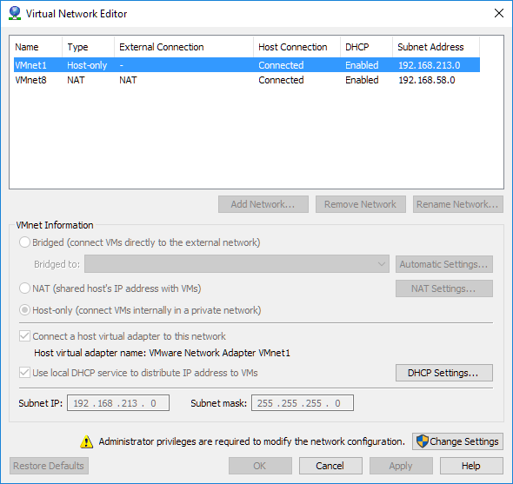
VM Virtual Network 설정
모든 VM을 중지한다.
Edit -> Virtual Network Editor -> Change Settings
Virtual Network Editor의 VMNet0 확인
Type: Bridged
External Connection : Intel® Dual Band ….

Slide 19
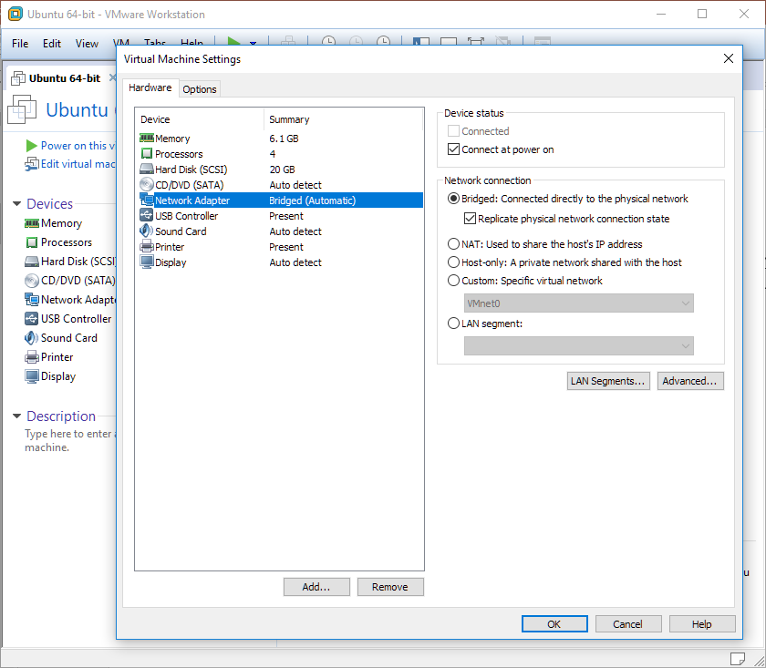
VM Network Connection 설정
Network Connection 을 Bridged를 선택한다.
Replice physical network connection state를 선택한다.

Slide 20
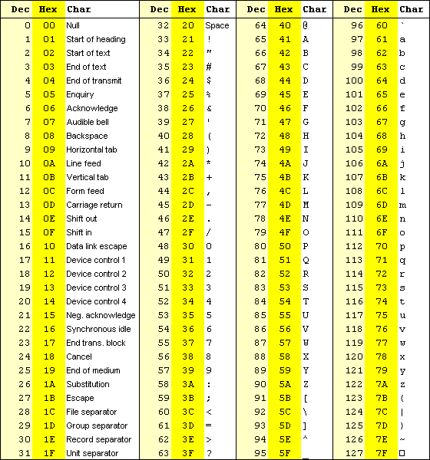
ASCII code table

Slide 21
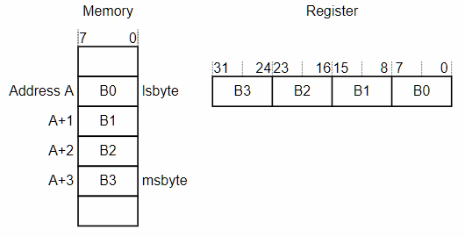
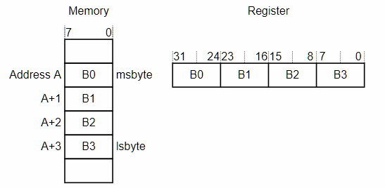
ENDIAN
Little Endian | Big Endian
작은 값이 메모리에 먼저 위치한다. the least significant byte at the lowest-numbered byte the most significant byte at the highest-numbered byte. X86/X64 아키텍쳐 | 큰 값이 메모리에 먼저 위치한다. the most significant byte at the lowest-numbered byte the least significant byte at the highest-numbered byte. Network IO / ARM 아키텍쳐
Little Endian
Big Endian

Slide 22
강의 개요
* 강의 빈도수
Kernel *
System Call ****
C Programming ***
Unix(Linux) **

Slide 23
Linux 개요 및 역사
리누스 토발즈가 개발한 Linux는 커널(kernel)을 뜻하지만, Linux 커널과 라이브러리와 도구들이 포함된 운영 체제를 뜻하기도 한다. Linux는 다중 사용자, 다중 작업, 다중 스레드를 지원하는 운영 체제이다.
Linux는 1991년 9월 인터넷을 통해 처음 공개되었다. 초기 Linux는 개인 개발자에 의해 개발되었으나, 이후 IBM, HP와 같은 기업의 후원을 받으면서 유닉스와 마이크로소프트 윈도우 운영 체제의 대안이 되었다. Linux는 오픈 소스의 특성에 힘입어 다양한 Linux 기반의 운영 체제가 배포되었다.
Linux는 벤더 독립성, 적은 개발비, 보안성 및 안전성으로 데스크톱 운영 체제로서도 인기가 높아지고 있다.
Linux는 인텔 386 CPU를 위해 개발되었으나, 현재는 개인용 컴퓨터에서부터 슈퍼컴퓨터는 물론 스마트폰과 같은 임베디드 시스템까지 이용되고 있다. 구글의 안드로이드는 대표적인 임베디드 Linux 운영 체제이다.
출처: https://ko.wikipedia.org/wiki/Linux

Slide 24



논리적 / 물리적
논리적 / Logical
사람의 생각으로 만든 것
물리적 / Physical
관찰 또는 측정이 가능 한 것

Slide 25

국화 옆에서
서정주
한 송이의 국화꽃을 피우기 위해 봄부터 소쩍새는 그렇게 울었나 보다. 한 송이의 국화꽃을 피우기 위해 천둥은 먹구름 속에서 또 그렇게 울었나 보다. 그립고 아쉬움에 가슴 조이던 머언 먼 젊음의 뒤안길에서 인제는 돌아와 거울 앞에 선 내 누님같이 생긴 꽃이여. 노오란 네 꽃잎이 피려고 간밤엔 무서리가 저리 내리고 내게는 잠도 오지 않았나 보다.

Slide 26
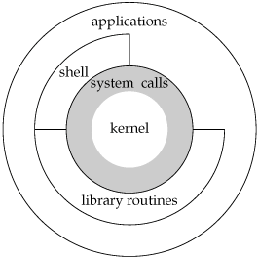
A Linux System Architecture Diagram

Slide 27
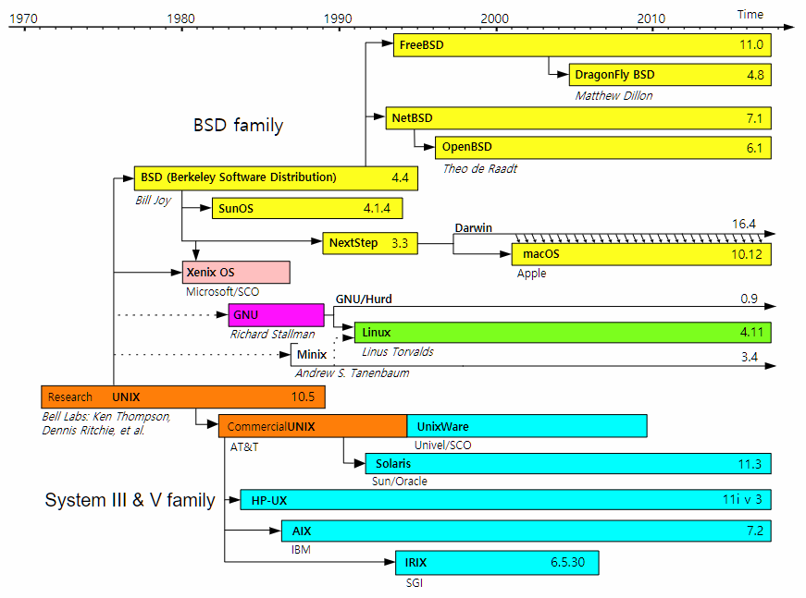
Unix History

Slide 28
Linux runlevel
A runlevel is one of the modes that a Unix -based operating system will run in. Each runlevel has a certain number of services stopped or started, giving the user control over the behavior of the machine.
Level | Mode | Action
0 | Halt | Shuts down system
1 | Single-User | Mode for administrative tasks.
2 | Multi-User | Does not configure network interfaces or start daemons.
3 | Multi-User with Networking | Starts the system normally.
4 | Not used | Not used/User-definable for special purposes
5 | X11 | As runlevel 3 + display manager(X)
6 | Reboot | Reboots the system
s or S | Single-User | Does not configure network interfaces, or start daemons.

Slide 29
Linux booting
디스크 동기화
sync
중지 명령어들
init 0
poweroff
halt
shutdown now
리부팅 명령어들
reboot
init 6

Slide 30

Linux 주요 명령어
Linux 주요 명령어
http://www.usm.uni-muenchen.de/people/puls/lessons/intro_general/Linux/Linux_for_beginners.pdf
Book
Unix Power Tools, 3rd ed.
By Mike Loukides
Publisher: O'Reilly Media
Release Date: February 2009
Pages: 1160
http://shop.oreilly.com/product/9780596003302.do

Slide 31
User/Group
유닉스의 사용자는 홈 디렉터리를 가진다.
파일을 조회/수정/실행에 관한 권한을 가진다.
sudo useradd newUser : 사용자 추가
sudo addgroup newGroup : 그룹 추가
sudo usermod –g newGroup newUser : 사용자 그룹변경

Slide 32
File
Unix Philosophy : Everything is file.
Unix는 파일과 디바이스 및 폴더가 동등한 개념이다.

Slide 33
C Programming Language
An Introduction to the C Programming Language and Software Design
http://www-personal.acfr.usyd.edu.au/tbailey/ctext/ctext.pdf

Slide 34
First C Program (p.3)
/* File Name : hello.c */
/* First C program: Hello World */
#include <stdio.h>
int main( int argc , char ** argv )
{
printf( "Hello World!\n" );
return 0 ;
}

Slide 35
printf
Syntax
int printf( const char *format [, arg]... );
Prints formatted output to the standard output stream.
If format includes format specifiers (subsequences beginning with %), the additional arguments following format are formatted and inserted in the resulting string replacing their respective specifiers.
참고 자료
http://www.cypress.com/file/54441/download

Slide 36
printf functions
option\target | stdout | file | string
 | printf | fprintf | sprintf
w | wprintf | fwprintf | swprintf | wide-character
n |  |  | snprintf
nw |  |  | snwprintf
No. | Syntax
1 | int printf ( const char *format [, argument] ... );
2 | int fprintf ( FILE *stream, const char *format [, argument] ... ); | *
3 | int sprintf ( char *buffer, const char *format [, argument] ... ); | x
4 | int snprintf( char *buffer, size_t count, const char *format [, argument] ... ); | O

Slide 37
Error Handling
CHAPTER 1

Slide 38




Why is an Error Handling important?
삼성증권 최악의 배당 사고.
주당 1000원을 배당해야 하는데, 전산실수로 주당 1000주(4000만원 상당)가 배정됐다. 이날 잘못 부여된 주식배당 물량이 113조원에 이른다.
유로컨트롤 "2만9천500편 가운데 절반 정도 이착륙 지연"
"1만 5,000대 비행기 발 묶여" 유럽 항공대란
유럽 항공교통 통제기구 기술적 문제
항공기 이착륙 지연, 공항마다 큰 혼잡
페이스북, 데이터 유출 사고
페이스북 계정 8,700만 건의 데이터가 미국 대선을 위한 타깃 광고에 부적절하게 활용된 사건
Intel CPU Meltdown 버그
“CPU들이 성능을 최적화하기 위해 적용하는 ‘추측 실행’(speculative execution) 기술로 인해 발생하는 심각한 보안 결함.
“허가 받지 않은 프로세스가 시스템 메모리에서 비밀번호나 암호화 열쇠 또는 다른 애플리케이션에 열려 있는 민감한 정보를 읽을 수 있다.

Slide 39
Error Handling (p. 21)
In system programming, an error is signified via a function’s return value and described via a special variable, errno.
This variable is declared in <errno.h> as follows:
extern int errno;
Erros and their descriptions
Table 1-2
errno
In single-thread, errno is a global variable.
In multi-threas, errno is stored per-thread, and is thus threadsafe.

Slide 40
(1) Error reporting (p. 22)
Name | perror( )
Desc | print a system error message
Desc | The perror( ) function produces a message on standard error describing the last error encountered during a call to a system or library function.
Synopsis | #include <stdio.h> void perror (const char *str);
Example | if (close (fd) == −1) perror ("close");

Slide 41
(2) Error reporting (p. 23)
Name | strerror( )
Desc | return string describing error number
Desc | The strerror() function returns a pointer to a string that describes the error code passed in the argument errnum, possibly using the LC_MESSAGES part of the current locale to select the appropriate language. (For example, if errnum is EINVAL, the returned description will be "Invalid argument".) This string must not be modified by the application, but may be modified by a subsequent call to strerror() or strerror_l(). No other library function will modify this string.
Synopsis | #include <stdio.h> char * strerror( int errnum );
Example | char * error_message = strerror( errnum ) ;

Slide 42
(3) Error reporting (p. 23)
Name | strerror_r
Desc | return string describing error number
Desc | The strerror_r() function is similar to strerror(), but is thread safe. A call to strerror_r() returns 0 on success, and −1 on failure. Humorously, it sets errno on error.
Synopsis | #include <string.h> int strerror_r (int errnum, char *buf, size_t len);
Ex. | char buf[100]; int err = strerror_r (errnum, buf, sizeof( buf ) );

Slide 43
(4) fflush (p. 82)
Name | fflush( )
Desc | flush a stream
Desc | For output streams, fflush() forces a write of all user-space buffered data for the given output or update stream via the stream's underlying write function.
Synopsis | #include <stdio.h> int fflush(FILE * stream);
Return value | Upon successful completion 0 is returned. Otherwise, EOF is returned and errno is set to indicate the error.
Example | fflush ( stdout );

Slide 44
perror( ) / strerror( ) Example
int main(int argc, char ** argv) {
int fd = -1;
errno = 0; // Always Reset errno before use.
printf( "\nTrying to open a file...." ) ;
fd = open("abcd",O_RDONLY);
if(fd == -1) {
printf( "\nerrono: %d" , errno );
printf("\nstrerror() : %s", strerror(errno) );
} else {
printf( "\nSuccess: open the file." );
}
return 0;
}

Slide 45
errno must be zeroed. (p. 23)
For a few functions, the entire range of the return type is a legal return value.
In those cases, errno must be zeroed before invocation and checked afterward.
these functions promise to only return a nonzero errno on actual error.
errno = 0;
ul = strtoul(buf, NULL, 0);
if( errno ){
perror ("strtoul");
}

Slide 46
preserve errno across function call. (p. 23)
if (fsync (fd) == −1) {
fprintf (stderr, "fsync failed!\n");
if (errno == EIO)
fprintf (stderr, "I/O error on %d!\n", fd);
}
if (fsync (fd) == −1) {
const int err = errno;
fprintf (stderr, "fsync failed: %s\n", strerror (errno));
if (err == EIO) {
/* if the error is I/O-related, jump ship */
fprintf (stderr, "I/O error on %d!\n", fd);
exit (EXIT_FAILURE);
}
}

Slide 47
FILE I/O
CHAPTER 2

Slide 48
Chapter Overview (p. 25)
This and the subsequent three chapters cover files.
This chapter covers the basics of file I/O.
Chapter 3
standard I/O from the standard C library.
Chapter 4
the more advanced and specialized file I/O.
Chapter 8
file and directory manipulation.

Slide 49
File descriptor 1/3 (p. 25)
Before a file can be read from or written to, it must be opened.
The kernel maintains a per-process list of open files, called the file table.
This table is indexed via nonnegative integers known as file descriptors (fds).
Each entry in the list contains information about an open file, including a pointer to an in-memory copy of the file’s backing inode and associated metadata, such as the file position and access modes.

Slide 50
File descriptor 2/3 (p. 25)
Because negative values are not legal file descriptors, −1 is often used to indicate an error from a function.
Unless the process explicitly closes them, every process by convention has at least three file descriptors open: 0, 1, and 2.
File descriptor 0 is standard in (stdin), file descriptor 1 is standard out (stdout), and file descriptor 2 is standard error (stderr).
Instead of referencing these integers directly, the C library provides the preprocessor defines STDIN_FILENO, STDOUT_FILENO, and STDERR_FILENO, respectively.
Normally, stdin is connected to the terminal’s input device (keyboard) and stdout and stderr are connected to the terminal’s display.
Users can redirect these standard file descriptors and even pipe the output of one program into the input of another. This is how the shell implements redirections and pipes.

Slide 51
File descriptor 3/3 (p. 26)
File descriptors can reference more than just regular files.
File descriptors are used for accessing device files and pipes, directories and futexes, FIFOs and sockets.
It follows the everything-is-a-file philosophy.
Anything you can read or write is accessible via a file descriptor.

Slide 52
Opening Files (p. 26)
#include <sys/types.h>
#include <sys/stat.h>
#include <fcntl.h>
#include <unistd.h>
int main( int argc , char ** argv ) {
int fd = -1;
fd = open("/home/kidd/madagascar", O_RDONLY);
if ( -1 == fd ) {
/* error */
fprintf( stdout, "file open error/" );
} else {
fprintf( stdout, "file open success." );
// closes a file descriptor and may be reused.
close( fd );
}
}

Slide 53
open (p. 26)
Name | open ( )
Desc | A file is opened and a file descriptor is obtained. If the specified file does not exist, it may optionally (if O_CREAT is specified in flags) be created by open().
Synopsis | #include <sys/types.h> #include <sys/stat.h> #include <fcntl.h> int open(const char *name, int flags); int open(const char *name, int flags, mode_t mode);
Return | A file descriptor, a small, nonnegative integer.
Example | int fd = open("/home/kidd/madagascar", O_RDONLY); O_RDONLY : reading only. O_WRONLY : writing only. O_RDWR : reading and writing.

Slide 54
create (p. 31)
Name | creat( )
Desc | create a new file or rewrite an existing one
Desc | The function call: creat(path, mode) shall be equivalent to: open(path, O_WRONLY|O_CREAT|O_TRUNC, mode)
Synopsis | #include <sys/types.h> #include <sys/stat.h> #include <fcntl.h> int creat(const char *name mode_t mode);
Return | A file descriptor, a small, nonnegative integer.
Example | int fd = creat( filename, 0644 ); if (fd == −1) /* error */

Slide 55
read (p. 32)
Name | read( )
Desc | read() attempts to read up to count bytes from file descriptor fd into the buffer starting at buf.
Synopsis | #include <unistd.h> ssize_t read (int fd, void *buf, size_t len);
Return value | On success, the number of bytes read is returned (zero indicates end of file), and the file position is advanced by this number. It is not an error if this number is smaller than the number of bytes requested; this may happen for example because fewer bytes are actually available right now (maybe because we were close to end-of-file, or because we are reading from a pipe, or from a terminal), or because read() was interrupted by a signal. On error, -1 is returned, and errno is set appropriately. In this case it is left unspecified whether the file position (if any) changes. If count is greater than SSIZE_MAX, the result is unspecified.
Example

Slide 56
write (p. 36)
Name | write( )
Desc | write() writes up to count bytes from the buffer starting at buf to the file referred to by the file descriptor fd.
Synopsis | #include <unistd.h> ssize_t write (int fd, const void *buf, size_t count);
Return value | On success, the number of bytes written is returned (zero indicates nothing was written). It is not an error if this number is smaller than the number of bytes requested; this may happen for example because the disk device was filled. On error, -1 is returned, and errno is set appropriately. If count is zero and fd refers to a regular file, then write() may return a failure status if one of the errors below is detected. If no errors are detected, or error detection is not performed, 0 will be returned without causing any other effect. If count is zero and fd refers to a file other than a regular file, the results are not specified.
Example

Slide 57
lseek (p. 46)
Name | lseek( )
Desc | lseek - reposition read/write file offset
Synopsis | #include <sys/types.h> #include <unistd.h> off_t lseek(int fd, off_t offset, int whence);
Description | lseek() repositions the file offset of the file descriptor fd to the argument offset according to the directive whence as follows: SEEK_SET The file offset is set to offset bytes. SEEK_CUR The file offset is set to its current location plus offset bytes. SEEK_END The file offset is set to the size of the file plus offset bytes. lseek() allows the file offset to be set beyond the end of the file (but this does not change the size of the file). If data is later written at this point, subsequent reads of the data in the gap (a "hole") return null bytes ('\0') until data is actually written into the gap.
Return Value | Upon successful completion, lseek() returns the resulting offset location as measured in bytes from the beginning of the file. On error, the value (off_t) -1 is returned and errno is set to indicate the error.

Slide 58
close (p. 45)
Name | close( )
Desc | unmap the file de‐scriptor from the associated file
Synopsis | #include <unistd.h> int close( int fd );
Return value | A call to close() unmaps the open file descriptor fd and disassociates the file from the process. The given file descriptor is then no longer valid, and the kernel is free to reuse it as the return value to a subsequent open() or creat() call. A call to close() returns 0 on success. On error, it returns −1 and sets errno appropriately. Note that closing a file has no bearing on when the file is flushed to disk. To ensure that a file is committed to disk before closing it, an application needs to make use of one of the synchronization options discussed earlier in “Synchronized I/O” on page 40.
Example | if (close (fd) == -1) perror ("close");

Slide 59
Opening Files (p. 26)
Flags for open( )
The flags argument is the bitwise-OR of one or more flags.
It must contain an access mode, which is one of O_RDONLY, O_WRONLY, or O_RDWR.
Respectively, these arguments request that the file be opened only for reading, only for writing, or for both reading and writing.
Flag Detail : (p. 27~ 28)
int fd; fd = open ("/home/teach/pearl", O_WRONLY | O_TRUNC); if (fd == -1) /* error */

Slide 60
Owners of New Files (p. 29)
Determining which user owns a new file is straightforward: the uid of the file’s owner is the effective uid of the process creating the file.
Determining the owning group is more complicated. The default behavior is to set the file’s group to the effective gid of the process creating the file.
Thankfully, you often need not care what group owns a file.

Slide 61
Permissions of New File (p. 29)
The mode argument is ignored unless a file is created; it is required if O_CREAT is given.
If you forget to provide the mode argument when using O_CREAT, the results are undefined and often quite ugly—so don’t forget!
When a file is created, the mode argument provides the permissions of the newly created file.
The mode is not checked on this particular open of the file, so you can perform operations that contradict the assigned permissions, such as opening the file for writing but assigning the file read-only permissions.
The mode argument is the familiar Unix permission bitset, such as octal 0644.
int open (const char *name, int flags); int open (const char *name, int flags, mode_t mode);

Slide 62
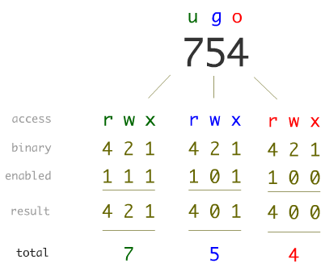
Unix File Permission

Slide 63
File open example (p. 31)
As an example, the following code opens the file given by file for writing.
If the file does not exist, assuming a umask of 022, it is created with the permissions 0644 (even though the mode argument specifies 0664). If it does exist, it is truncated to zero length:
fd = open (file, O_WRONLY|O_CREAT|O_TRUNC ,
S_IWUSR|S_IRUSR|S_IWGRP|S_IRGRP|S_IROTH);
fd = open (file, O_WRONLY|O_CREAT|O_TRUNC, 0664);

Slide 64
The creat( ) Function (p. 31)
The combination of O_WRONLY | O_CREAT | O_TRUNC is so common that a system call exists to provide just that behavior:
int creat (const char *name, mode_t mode);
It can be implemented in user space as simply:
int creat (const char *name, int mode) { return open (name, O_WRONLY | O_CREAT | O_TRUNC, mode); }
Return Values and Error Codes
Both open() and creat() return a file descriptor on success.
On error, both return −1, and set errno to an appropriate error value

Slide 65
Reading via read( ) (p. 32)
Syntax #include <unistd.h> ssize_t read (int fd, void *buf, size_t len);
A call try to read up to len bytes into the buf .
On success, the number of bytes written into buf is returned.
On error, the call returns -1 and sets errno.
The file position is advanced by the number of bytes read from fd.

Slide 66
Example of read( ) (p. 32)
The number of bytes to read is equal to the size of the unsigned long type.
4 bytes on 32-bit systems
8 bytes on 64-bit systems.
nr contains the number of bytes read success, or −1 on error:
The call might return without reading all len bytes.
unsigned long word; ssize_t nr; nr = read (fd, &word, sizeof(unsigned long)); if (nr == -1) /* error */

Slide 67
Return values of read( ) ½ (p. 33)
It is legal for read() to return a positive nonzero value less than len.
less than len bytes may have been available.
interrupted by a signal, and so on.
The possibility of a return value of 0
The read() system call returns 0 to indicate end-of-file (EOF);
No bytes were read.
EOF is not an error.
Blocking Mode : Sleep
If a call is made for len bytes, but no bytes are available for reading, the call will block until the bytes become available.
In the case of blocking, the read is waiting for more data
in the case of reading from a socket or a device file.

Slide 68
Return values of read( ) 2/2 (p. 33)
The call returns a value equal to len. All len read bytes are stored in buf.
The call returns a value less than len, but greater than zero.
Reissuing the read will read the remaining bytes into the rest of the buffer.
The call blocks when no data is currently available.
This won’t happen in non‐blocking mode.
The call returns -1
errno == EINTR
A signal was re‐ceived before any bytes were read.
errno == EAGAIN
The read would block because no data is currently available.
The request should be reissued later.
Another errno
A more serious error.

Slide 69
Reading All the Bytes (p. 34)
It handles all errors and actually read all len bytes (at least up to an EOF).
ssize_t ret; while (len != 0 && (ret = read (fd, buf, len)) != 0) { if (ret == -1) { if (errno == EINTR) { // signal interrup continue;
} perror ("read"); break; } len -= ret; buf += ret; }

Slide 70
Nonblocking Reads ½ (p. 35)
Sometimes, programmers do not want a call to read() to block when there is no data available.
Instead, they prefer that the call return immediately, indicating that no data is available.
Nonblocking I/O allows applications to perform I/O on multiple files.

Slide 71
Nonblocking Reads 2/2 (p. 35)
An additional errno value EAGAIN is worth checking:.
if O_NONBLOCK was given to open()
char buf[BUFSIZ]; ssize_t nr; start: nr = read (fd, buf, BUFSIZ); if (nr == -1) { if (errno == EINTR) // signal interrupt goto start; /* oh shush */ if (errno == EAGAIN) /* resubmit later */ else /* error */ }

Slide 72
Other Error Values (p. 35)
EBADF
The given file descriptor is invalid or is not open for reading.
EFAULT
The pointer provided by buf is not inside the calling process’s address space.
EINVAL
The file descriptor is mapped to an object that does not allow reading.
EIO
A low-level I/O error occurred.

Slide 73
ssize_t (p. 36)
The size_t and ssize_t types are mandated by POSIX.
The size_t type is used for storing values used to measure size in bytes.
The ssize_t type is a signed version of size_t.
On 32-bit systems, the backing C types are usually unsigned int and int, respectively.
Because the two types are often used together, the potentially smaller range of ssize_t places a limit on the range of size_t.

Slide 74
Size Limits on read() (p. 36)
The maximum value of a size_t is SIZE_MAX;
If len is larger than SSIZE_MAX, the results of the call to read() are undefined.
On most Linux systems, SSIZE_MAX is LONG_MAX, which is 2,147,483,647 on a 32-bit machine.
if (len > SSIZE_MAX) { len = SSIZE_MAX;
}

Slide 75
Writing with write() ½ (p. 36)
write() is the counterpart of read() .
#include <unistd.h>
ssize_t write (int fd, const void *buf, size_t count);
A call to write() writes up to count bytes starting at buf.
Return Value
On success :
the number of bytes written is returned
and the file position is updated in kind.
return 0 :
it simply implies that zero bytes were written.
On error
−1 is returned and errno is set appropriately.

Slide 76
Writing with write() 2/2 (p. 37)
Basic usage
const char *buf = "My ship is solid!"; ssize_t nr; /* write the string in 'buf' to 'fd' */ nr = write (fd, buf, strlen (buf)); if (nr == -1) /* error */
Partial Write
unsigned long word = 1720; size_t count; ssize_t nr; count = sizeof (word); nr = write (fd, &word, count); if (nr == -1) /* error, check errno */ else if (nr != count) /* possible error, but 'errno' not set */

Slide 77
Partial Writes (p. 37)
The write() system call is less likely to return a partial write than the read().
For regular files
write() is guaranteed to perform the entire requested write.
For other file types like sockets
a loop may be required to guarantee that you really write out all of the requested bytes.
ssize_t ret, nr; while (len != 0 && (ret = write (fd, buf, len)) != 0) { if (ret == -1) { if (errno == EINTR) continue; perror ("write"); break;
} len -= ret; buf += ret; }

Slide 78
Append Mode (p. 38)
When fd is opened in append mode (via O_APPEND),
Writings occur at the current end of the file.

Slide 79
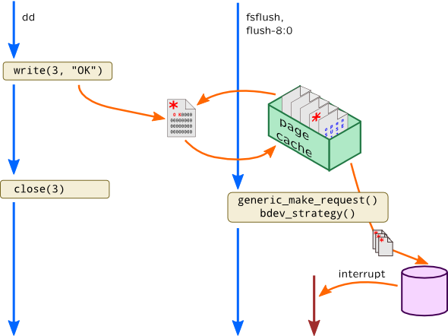
Behavior of write() (p. 39)
When a call to write(),
the kernel has copied the data from the supplied buffer into a kernel buffer
there is no guarantee that the data has been written out to its destination.
Later, in the background,
the kernel gathers up all of the dirty buffers
writes them out to disk.

Slide 80
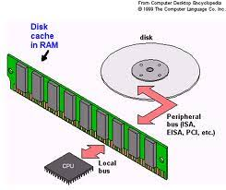
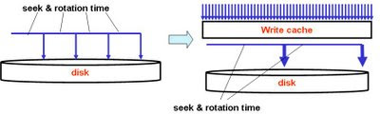
Synchronized I/O (p. 40)
Buffering writes provides a significant performance improvement.
A fsync() ensures that data has reached the disk.
#include <unistd.h>
int fsync (int fd);
In the presence of hard disks with write caches,
it is not possible for fsync() to know whether the data is physically on the disk.
The hard drive can report that the data was written, but the data may reside in the drive’s cache.
A call to fdatasync() does the same thing as fsync().
The call does not guarantee that nonessential metadata is synchronized to disk.
#include <unistd.h>
int fdatasync (int fd);

Slide 81
sync() (p. 43)
The sync() system call is provided for synchronizing all buffers to disk:
#include <unistd.h>
void sync (void);
The function has no parameters and no return value.
It always succeeds and, upon return, all buffers—both data and metadata—are guaranteed to reside on disk.

Slide 82
The O_SYNC Flag (p. 43)
The O_SYNC flag may be passed to open(), indicating that all I/O on the file should be synchronized:
int fd = open (file, O_WRONLY | O_SYNC);
Read requests are always synchronized.
However, calls to write() are normally not synchronized.

Slide 83
Direct I/O
Providing the O_DIRECT flag to open()
minimize the presence of I/O management.
Direct I/O will initiate directly from user-space buffers to the device, bypassing the page cache.
Direct I/O will be synchronous.
operations will not return until completed.
The request length, buffer alignment, and file offsets must be integer multiples of the device’s sector size.
generally, this is 512 bytes.

Slide 84
Seeking with lseek() ½ (p. 46)
The lseek() system call is provided to set the file position of a file descriptor to a given value.
#include <sys/types.h>
#include <unistd.h>
off_t lseek(int fd,off_t pos,int origin);
The origin argument
SEEK_CUR
The file position is set to its current value plus pos.
SEEK_END
The file position is set to the length of the file plus pos.
SEEK_SET
The file position is set to pos.

Slide 85
Seeking with lseek() 2/2 (p. 47)
Set the file position of fd
off_t ret;
ret = lseek (fd, (off_t) 1825, SEEK_SET);
if (ret == (off_t) −1) /* error */
Set the file position of fd to the end of the file:
off_t ret;
ret = lseek (fd, 0, SEEK_END);
if (ret == (off_t) −1) /* error */
As lseek() can be used to find the current file position:
int pos;
pos = lseek (fd, 0, SEEK_CUR);
if (pos == (off_t) −1) /* error */

Slide 86
실습: 파일 복사 프로그램 작성
c main function argc, argv
example : a05_argument.c
read(), write() 함수를 이용하여 파일을 복사하는 프로그램을 작성하세요.
소스 파일 이름: file_copy.c
프로그램 내용:
실행 프로그램의 두 번재 argument 값의 파일의 내용을 세번째 argument 값의 파일로 복사한다.

Slide 87

Qt 프로그램 예제 실행
https://www.qt.io/what-is-qt/
Qt-Creator 실행
Qt-Example 실행

Slide 88
Buffered I/O
CHAPTER 3

Slide 89
Buffered I/O
Buffered I/O
= User-Buffered I/O
= Standard C I/O
= stdio
= File Pointer
= FILE * file
= stream
fopen() , fread(), fwrite() , fclose()

Slide 90
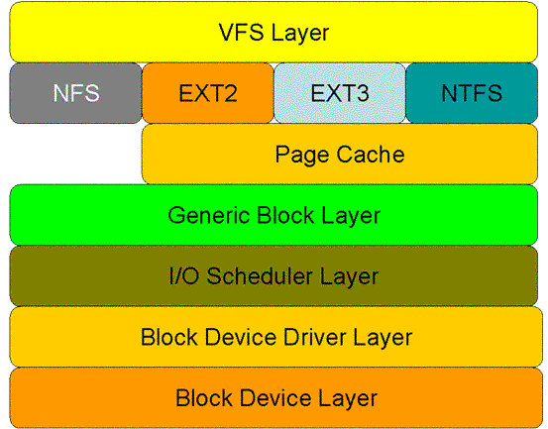
Block (p. 67)
The block is an abstraction representing the smallest unit of storage on a filesystem.
Inside the kernel, all filesystem operations occur in terms of blocks.
No I/O operation may execute on an amount of data less than the block size or that is not an integer multiple of the block size.
If you only want to read a byte, too bad:
you’ll have to read a whole block.
Want to write 4.5 blocks worth of data?
You’ll need to write 5 blocks, which implies reading that partial block in its entirety, updating only the half you’ve changed, and then writing back the whole block.

Slide 91
User-Buffered I/O (p. 67)
Programs that have to issue many small I/O requests to regular files often perform user-buffered I/O.
Buffered I/O refers to buffering done in user space, either manually by the application or transparently in a library, not to buffering done by the kernel.
In practice, blocks are usually 512, 1,024, 2,048, 4,096, or 8,192 bytes in size.
User-buffered I/O closes the gap between the filesystem, which speaks in blocks, and the application, which talks in its own abstractions.

Slide 92
C Standard I/O (p. 70)
The standard C library provides the standard I/O library (often simply called stdio).
It provides a platform-independent, user-buffering solution.
The standard I/O library is simple to use, yet powerful.
The remainder of this chapter discusses user-buffered I/O as it pertains to file I/O.
It is implemented in the standard C library.
Opening, closing, reading, and writing files via the standard C library.

Slide 93

File Pointers (p. 70)
Standard I/O routines do not operate directly on file descriptors.
SIO use their own unique identifier, known as the file pointer.
The file pointer maps to a file descriptor.
The file pointer is represented by a pointer to the FILE typedef.
An open file is called a stream.
Streams may be opened for reading (input streams), writing (output streams), or both (input/output streams).

Slide 94
Opening Files (p. 71)
Files are opened for reading or writing via fopen():
#include <stdio.h>
FILE * fopen (const char *path, const char *mode);
This function opens the file path with the behavior given by mode and associates a new stream with it.
Modes : The mode argument describes how to open the given file.
r : Open the file for reading.
r+ : Open the file for both reading and writing.
w : Open the file for writing.
If the file exists, it is truncated to zero length. If the file does not exist, it is created.
w+ : Open the file for both reading and writing.
If the file exists, it is truncated to zero length. If the file does not exist, it is created.
a : Open the file for writing in append mode.
The file is created if it does not exist. The stream is positioned at the end of the file.
a+ : Open the file for both reading and writing in append mode.
The file is created if it does not exist. The stream is positioned at the end of the file.

Slide 95
Opening Files (p. 72)
Example
FILE *stream;
stream = fopen ("/etc/manifest", "r");
if(!stream)
/* error */
Opening a Stream via File Descriptor
The function fdopen() converts an already open file descriptor (fd) to a stream:
#include <stdio.h>
FILE * fdopen(int fd, const char *mode);

Slide 96
Closing Streams (p. 73)
The fclose() function closes a given stream:
#include <stdio.h>
int fclose(FILE *stream);
Any buffered and not-yet-written data is first flushed. On success, fclose() returns 0.
On failure, it returns EOF and sets errno appropriately.

Slide 97
Closing All Streams (p. 73)
The fcloseall() function closes all streams associated with the current process, including standard in, standard out, and standard error:
#define _GNU_SOURCE
#include <stdio.h>
int fcloseall (void);
Before closing, all streams are flushed.
The function always returns 0.
it is Linux-specific.

Slide 98
Reading from a Stream (p. 74)
The function fgetc() is used to read a single character from a stream:
#include <stdio.h>
int fgetc (FILE *stream);
This function reads the next character from stream and returns it as an unsigned char cast to an int.
Example
int c;
c = fgetc(stream);
if (c == EOF)
/* error */
else
printf ("c=%c\n", (char) c);

Slide 99
Putting the character back (p. 74)
Standard I/O provides a function for pushing a character back onto a stream,
#include <stdio.h>
int ungetc (int c, FILE *stream);
Each call pushes back c, cast to an unsigned char, onto stream.
On success, c is returned;
on failure, EOF is returned. A subsequent read from stream will return c.

Slide 100
Reading an Entire Line (p. 75)
The function fgets() reads a string from a given stream:
#include <stdio.h>
char * fgets (char *str, int size, FILE *stream);
This function reads up to one less than size bytes from stream and stores the results in str. A null character (\0) is stored in the buffer after the last byte read in.
Reading stops after an EOF or a newline character is reached.
If a newline is read, the \n is stored in str.
On success, str is returned; on failure, NULL is returned. For example: char buf[LINE_MAX]; if (!fgets (buf, LINE_MAX, stream)) /* error */

Slide 101
Reading arbitrary string ½ (p. 75)
Sometimes, developers want to use a delimiter other than the newline. Other times, developers do not want a delimiter at all—and rarely do developers want the delimiter stored in the buffer!
This snippet reads the n − 1 bytes from stream into str, and then appends a \0 character.
char *s;
int c;
s = str;
while (--n > 0 && (c = fgetc (stream)) != EOF) {
*s++ = c;
}
*s = '\0';
Ex :

Slide 102
Reading arbitrary string 2/2 (p. 76)
The snippet can be expanded to also stop reading at a delimiter, given by the integer d (which cannot be the null character in this example):
char *s;
int c = 0;
s = str;
while (--n > 0 && (c = fgetc (stream)) != EOF && (*s++ = c) != d) {
// do nothing.
} ;
if (c == d) {
*--s = '\0';
} else {
*s = '\0';
}
Ex :

Slide 103
Reading Binary Data (p. 75)
Developers want to read and write complex binary data, such as C structures.
#include <stdio.h>
size_t fread (void *buf, size_t size, size_t nr, FILE *stream);
A call to fread() will read up to nr elements of data, each of size bytes, from stream into the buffer pointed at by buf.
The number of elements read (not the number of bytes read!) is returned.
The function indicates failure or EOF via a return value less than nr.
Ex :
char buf[64];
size_t nr;
nr = fread (buf, sizeof(buf), 1, stream);
if (nr == 0)
/* error */

Slide 104
Writing a single character (p. 78)
The counterpart of fgetc() is fputc():
#include <stdio.h>
int fputc (int c, FILE *stream);
The fputc() function writes the byte specified by c (cast to an unsigned char) to the stream pointed at by stream.
Upon successful completion, the function returns c.
Otherwise, it returns EOF, and errno is set appropriately.
Example :
if (fputc ('p', stream) == EOF)
/* error */

Slide 105
Wring a String of Characters (p. 78)
The function fputs() is used to write an entire string to a given stream:
#include <stdio.h>
int fputs (const char *str, FILE *stream);
A call to fputs() writes all of the null-terminated string pointed at by str to the stream pointed at by stream.
On success, fputs() returns a nonnegative number.
On failure, it returns EOF.
Ex :
FILE *stream;
stream = fopen ("journal.txt", "a");
if (!stream)
/* error */
if (fputs("The ship is made of wood.\n", stream) == EOF)
/* error */
if (fclose (stream) == EOF)
/* error */

Slide 106
Writing Binary Data (p. 79)
To directly store binary data, standard I/O provides fwrite():
#include <stdio.h>
size_t fwrite (void *buf, size_t size, size_t nr, FILE *stream);
A call to fwrite() will write to stream up to nr elements, each size bytes in length, from the data pointed at by buf.
The file pointer will be advanced by the total number of bytes written.
The number of elements (not the number of bytes!) successfully written will be returned.
A return value less than nr denotes error.

Slide 107
Sample Program Using Buffered I/O 1/3 (p. 79)
This program first defines struct pirate and then declares two variables of that type.
The program initializes one of the variables and subsequently writes it out to disk via an output stream to the file data.
Via a different stream, the program reads the data back in from data directly to the other instance of struct pirate.
Finally, the program writes the contents of the structure to standard out:

Slide 108
Sample Program Using Buffered I/O 2/3 (p. 79)
#include <stdio.h>
int main (void) {
FILE *in, *out;
struct pirate {
char name[100]; /* real name */
unsigned long booty; /* in pounds sterling */
unsigned int beard_len; /* in inches */
} ;
pirate p, blackbeard = { "Edward Teach", 950, 48 };
out = fopen ("data.txt", "w");
if (!out) {
perror ("fopen");
return 1;
}
if (!fwrite (&blackbeard, sizeof(struct pirate), 1, out)) {
perror ("fwrite");
return 1;
}

Slide 109
Sample Program Using Buffered I/O 3/3 (p. 80)
if (fclose (out)) {
perror ("fclose");
return 1;
}
in = fopen ("data.txt", "r");
if (!in) {
perror ("fopen");
return 1;
}
if (!fread (&p, sizeof (struct pirate), 1, in)) {
perror ("fread");
return 1;
}
if (fclose (in)) {
perror ("fclose");
return 1;
}
printf ("name=\"%s\" booty=%lu beard_len=%u\n", p.name, p.booty, p.beard_len);
return 0;
}

Slide 110
Seeking a stream (p. 80)
The fseek() function manipulates the file position of stream in accordance with offset and whence:
#include <stdio.h>
int fseek (FILE *stream, long offset, int whence);
If whence is set to SEEK_SET, the file position is set to offset.
If whence is set to SEEK_CUR, the file position is set to the current position plus offset.
If whence is set to SEEK_END, the file position is set to the end of the file plus offset.
Upon successful completion, fseek() returns 0, clears the EOF indicator, and undoes the effects (if any) of ungetc().
On error, it returns −1, and errno is set appropriately.
The most common errors are invalid stream (EBADF) and invalid whence argument (EINVAL).

Slide 111
Obtaining the Current Stream Position( p. 82)
Unlike lseek(), fseek() does not return the updated position. A separate interface is provided for this purpose. The ftell() function returns the current stream position of stream:
#include <stdio.h>
long ftell (FILE *stream);
On error, it returns −1 and errno is set appropriately.

Slide 112
Flushing a Stream ½ (p. 82)
The standard I/O library provides an interface for writing out the user buffer to the kernel, ensuring that all data written to a stream is flushed via write().
#include <stdio.h>
int fflush (FILE *stream);
On invocation, any unwritten data in the stream pointed to by stream is flushed to the kernel.
If stream is NULL, all open input streams in the process are flushed.
On success, fflush() returns 0.
On failure, it returns EOF, and errno is set appropriately.
To understand the effect of fflush(), you have to understand the difference between the buffer maintained by the C library and the kernel’s own buffering.
All of the calls described in this chapter work with a buffer that is maintained by the C library, which resides in user space, not kernel space.
That is where the performance improvement comes in—you are staying in user space and therefore running user code, not issuing system calls.
A system call is issued only when the disk or some other medium has to be accessed.

Slide 113
Flusing a Stream 2/2 (p.83)
fflush() merely writes the user-buffered data out to the kernel buffer.
The effect is the same as if user buffering was not employed and write() was used directly.
It does not guarantee that the data is physically committed to any medium—for that need, use something like fsync().
Tol ensure that your data is commited to the backing store, you will want to call fflush(), followed immediately by fsync():
First ensure that the user buffer is written out to the kernel
Then ensure that the kernel’s buffer is written out to disk.

Slide 114
실습: 파일 복사 프로그램 작성
fgetc(), fputc() 함수를 이용하여 파일을 복사하는 프로그램을 작성하세요.
소스 파일 이름: file_copy.c
프로그램 내용:
실행 프로그램의 두 번재 argument 값의 파일의 내용을 세번째 argument 값의 파일로 복사한다.

Slide 115
Socket Programming
Network

Slide 116
Programs, Processes, and Threads (p. 137)
Program :
A binary is compiled, executable code lying dormant on a storage medium such as a disk.
Large and significant binaries we might call applications.
A process is a running program.
A process includes the binary image, loaded into memory.
It incluses an instance of virtualized memory, kernel resources such as open files, a security context such as an associated user, and one or more threads.
A thread is the unit of activity inside of a process.
Each thread has its own virtualized processor.
It includes a stack, processor state such as registers, and an instruction pointer.
In a single threaded process, the process is the thread.
There is one instance of virtualized memory and one virtualized processor.
In a multithreaded process, there are multiple threads.
As the virtualization of memory is associated with the process, the threads all share the same memory address space.

Slide 117
The Process ID (p. 138)
Each process is represented by a unique identifier, the process ID.
The pid is guaranteed to be unique at any single point in time.
From the view of a process, its pid never changes.
The process ID is represented by the pid_t type.
It is defined in the header file <sys/types.h>.
The exact backing C type is architecture-specific and not defined by any C standard.
On Linux, however, pid_t is generally a typedef to the C int type.

Slide 118
The Process ID and Parent Process ID (p. 140)
The getpid() system call returns the process ID of the invoking process:
#include <sys/types.h>
#include <unistd.h>
pid_t getpid (void);
The getppid() system call returns the process ID of the invoking process’s parent:
#include <sys/types.h>
#include <unistd.h>
pid_t getppid (void);
Neither call will return an error. Consequently, usage is trivial:
printf ("My pid=%jd\n", (intmax_t) getpid ());
printf ("Parent's pid=%jd\n", (intmax_t) getppid ());
Here, we typecast the return value to intmax_t, which is a C/C++ type guaranteed to be capable of storing any signed integer value on the system.
Coupled with a printf() modifier (%j), this approach lets us safely print integers represented by a typedef.

Slide 119
The fork() System Call (p. 145)
A new process running the same image as the current one can be created via the fork() system call:
#include <sys/types.h>
#include <unistd.h>
pid_t fork (void);
A successful call to fork() creates a new process which is called the “child” of the original process.
In the child, a successful invocation of fork() returns 0.
In the parent, fork() returns the pid of the child.
The child and the parent process are identical in nearly every facet, except for a few necessary differences:
The pid of the child is, of course, newly allocated and different from that of the parent.
The child’s parent pid is set to the pid of its parent process.
Resource statistics are reset to zero in the child.
Any pending signals are cleared and not inherited by the child (see Chapter 10).
Any acquired file locks are not inherited by the child.
On error, a child process is not created, fork() returns −1, and errno is set appropriately.

Slide 120
fork() example (p. 145)
fork sample:
pid_t pid;
pid = fork ();
if (pid > 0)
printf ("I am the parent of pid=%d!\n", pid);
else if (!pid)
printf ("I am the child!\n");
else if (pid == −1)
perror ("fork");
The most common usage of fork() is to create a new process in which a new binary image is then loaded.
First the process forks a new process, and then the child executes a new binary image.

Slide 121
Creating Threads (p. 228)
Pthreads provides a single function to define and launch a new thread, pthread_create():
#include <pthread.h>
int pthread_create (pthread_t *thread, const pthread_attr_t *attr,
void *(*start_routine) (void *), void *arg );
Upon successful invocation, a new thread is created and begins executing the function provided by start_routine, passed the sole argument arg.
The function will store the thread ID, used to represent the new thread, in the pthread_t pointed at by thread.
The start_routine must have the following signature:
void * start_thread (void *arg);
Thus, the thread begins life by executing a function that accepts a void pointer as its sole argument and returns a void pointer as its return value.

Slide 122
Thread Example (p. 229)
Example usage:
pthread_t tread;
int ret;
ret = pthread_create (&thread, NULL, start_routine, NULL);
if (!ret) {
errno = ret;
perror("pthread_create");
return -1;
}

Slide 123
A thread example (p. 234)
#include <stdlib.h>
#include <stdio.h>
#include <pthread.h>
void * start_thread (void *message) {
printf ("%s\n", (const char *) message);
return message;
}
int main (void) {
pthread_t thing1, thing2;
const char *message1 = "Thing 1";
const char *message2 = "Thing 2";
/* create threads */
pthread_create (&thing1, NULL, start_thread, (void *) message1);
pthread_create (&thing2, NULL, start_thread, (void *) message2);
/* Wait for the threads to exit. */
pthread_join (thing1, NULL);
pthread_join (thing2, NULL);
return 0;
}
$ gcc -Wall -O2 -pthread example.c -o example

Slide 124
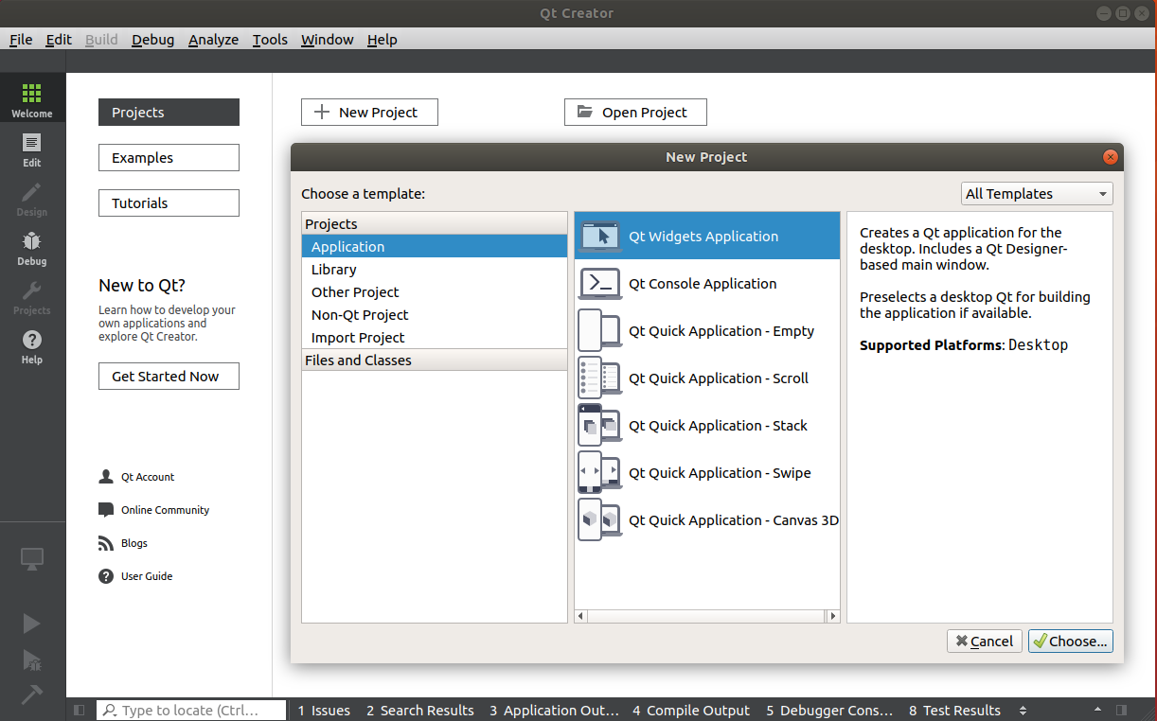
Qt Project Create

Slide 125
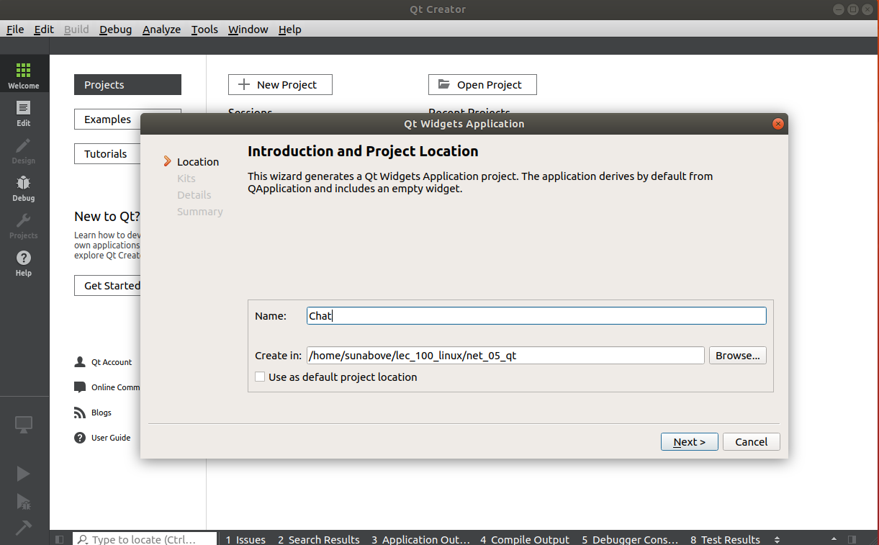
프로젝트 폴더 설정

Slide 126
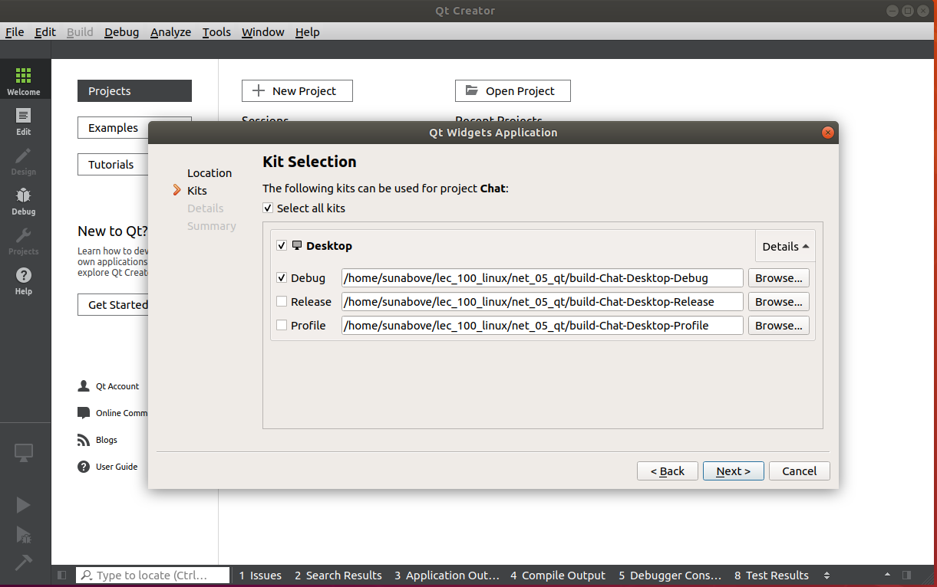
Kit Selection

Slide 127
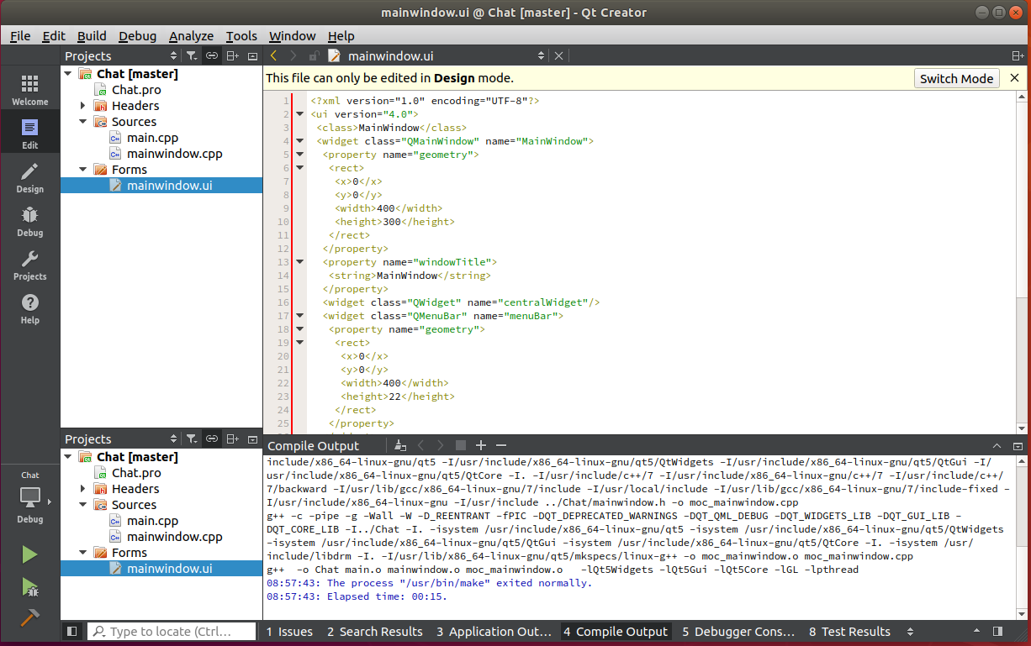
UI 디자인 파일

Slide 128
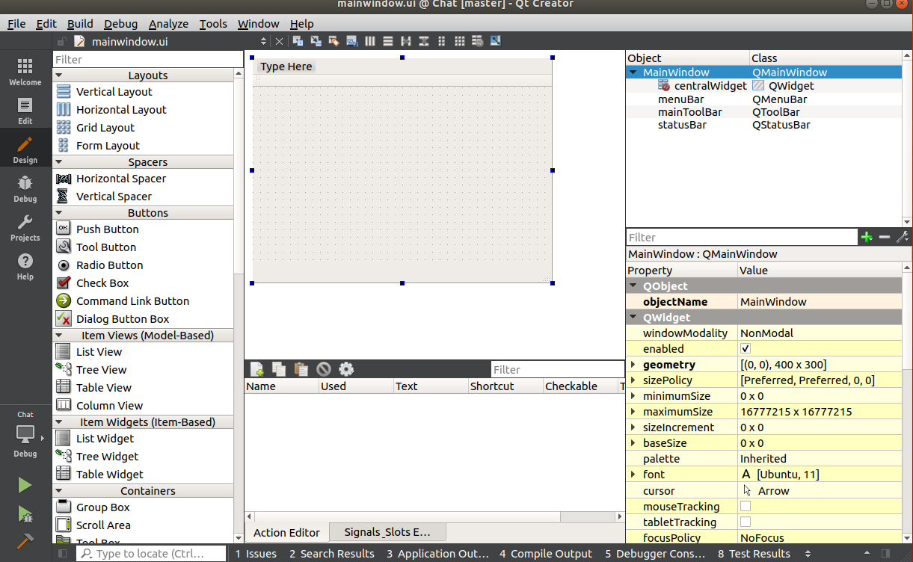
UI 디자인

Slide 129
끝.

